Slide 1
Introductory Aquaculture
Subtitle

Slide 2
United States Aquaculture Development
Early emphasis was on restocking depleted water ways
Not on the advancement of food crops
New England states established fish and game commissions
Combined interest lead the formation of the American Fish Cultural society in 1870, 1885 it became the American Fisheries Society and this eventually became U.S. Fish and Wildlife Service.
Two fish species dominated U.S. aquaculture development
catfish and trout
Two states dominated-
Mississippi and Idaho

Slide 3
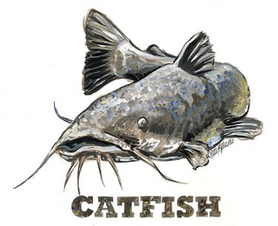
Catfish and Mississippi
History
Research for better production and commercial fish farming
Commercial warmwater fish farming began in the 1920 and 30’s
Raising minnows to supply bait for sport fishing
Post WWII, -demand for minnows increased b/c of all CCC projects - pond and reservoir construction
1950’s- # of producers increased enormously. Fish farmers started raising food fish i.e. buffaloes, bass & crappies
most attempts failed b/c lack of experience and low value species
Land grant universities joined in the research
Farmers received technology through intensive extension efforts involving the Fish Farming Experiment Station, State Cooperative Extension services and U.S. Dept. Of Agriculture.
Sea Grant Program of 1966 provided grants(federal monies) to universities that are designated as sea grant colleges.

Slide 4
Warmwater aquaculture- 1960’s Mississippi accounts for 70% of U.S. catfish sales
Pioneering phase of catfish industry – phase 1
Phase 2- 1971 to 1976
High production costs resulting in low yields and inefficiency
Farm raised catfish faced severe competition channel catfish caught in the rivers by commercial fishermen and imported fish.
Low product acceptance outside of the deep south
Lack of effective marketing
Production improvement and unit cost declined
Processing (typically Fall) became less seasonal
Unprofitable and marginal producers left the business b/c of increased feed cost and scarcity of fish meal.
Demand rose, marketing strategy improved.

Slide 5
Phase 3 1977 -1982
Productivity continued to improve.
Acreage increased, production cost declined.
Major sales outlet become the processed fish market.
Vertical integration started b/c processors needed to handle a constant volume of fish through out the year.
A fall production peak is a built in feature of the catfish industry b/c most of the fish stocked as fingerlings in spring reached harvest size in the fall.

Slide 6
Add a Slide Title - 4

Slide 7
Add a Slide Title - 5

