Slide 1
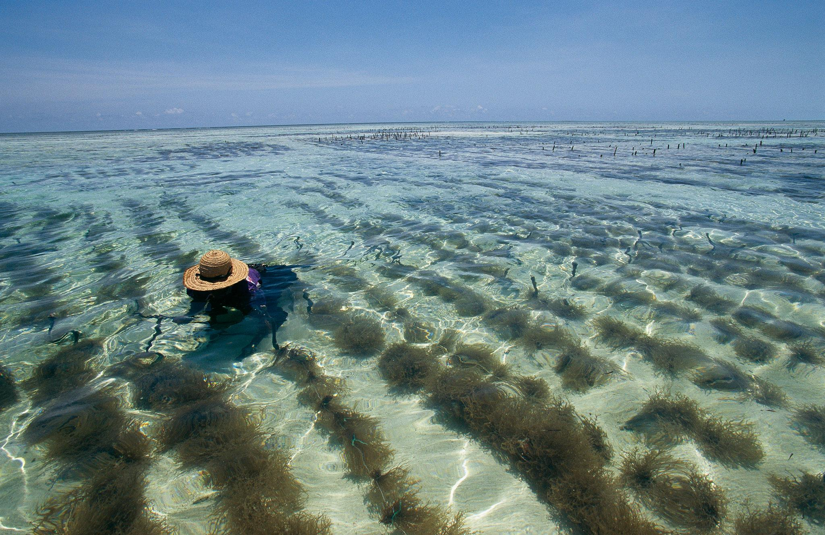
History of Aquaculture

Slide 2
Chinese Aquaculture
3500 BC started with carp on silkworm farms and fed fish off larva and feces.
Polyculture- More than one fish because Emperor Li stopped the eating of carp because they were sacred. So started growing lots of different types.
Species
Grass Carp
Bighead Carp
Silver Carp
Mud Carp
Location
Topwater
Midwater
Midwater
Bottom
Feed
Large vegetation near shore
Minute animals known as zooplankton
Minute plants or algae known as phytoplankton
Wide variety of plants and animals

Slide 3
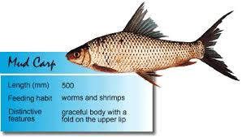
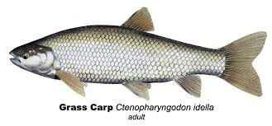
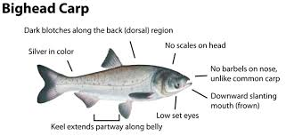
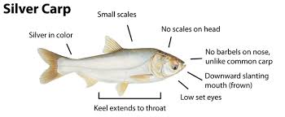
1963: 3 species of carp introduced from china to U.S.A.

Slide 4
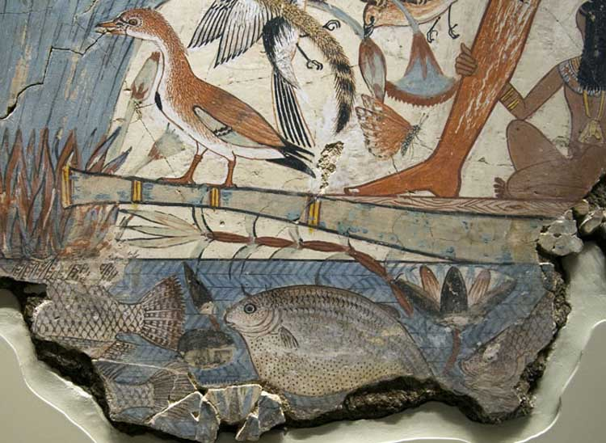
Egypt
2000 BC: Tilapia were raised as a part of irrigation

Slide 5
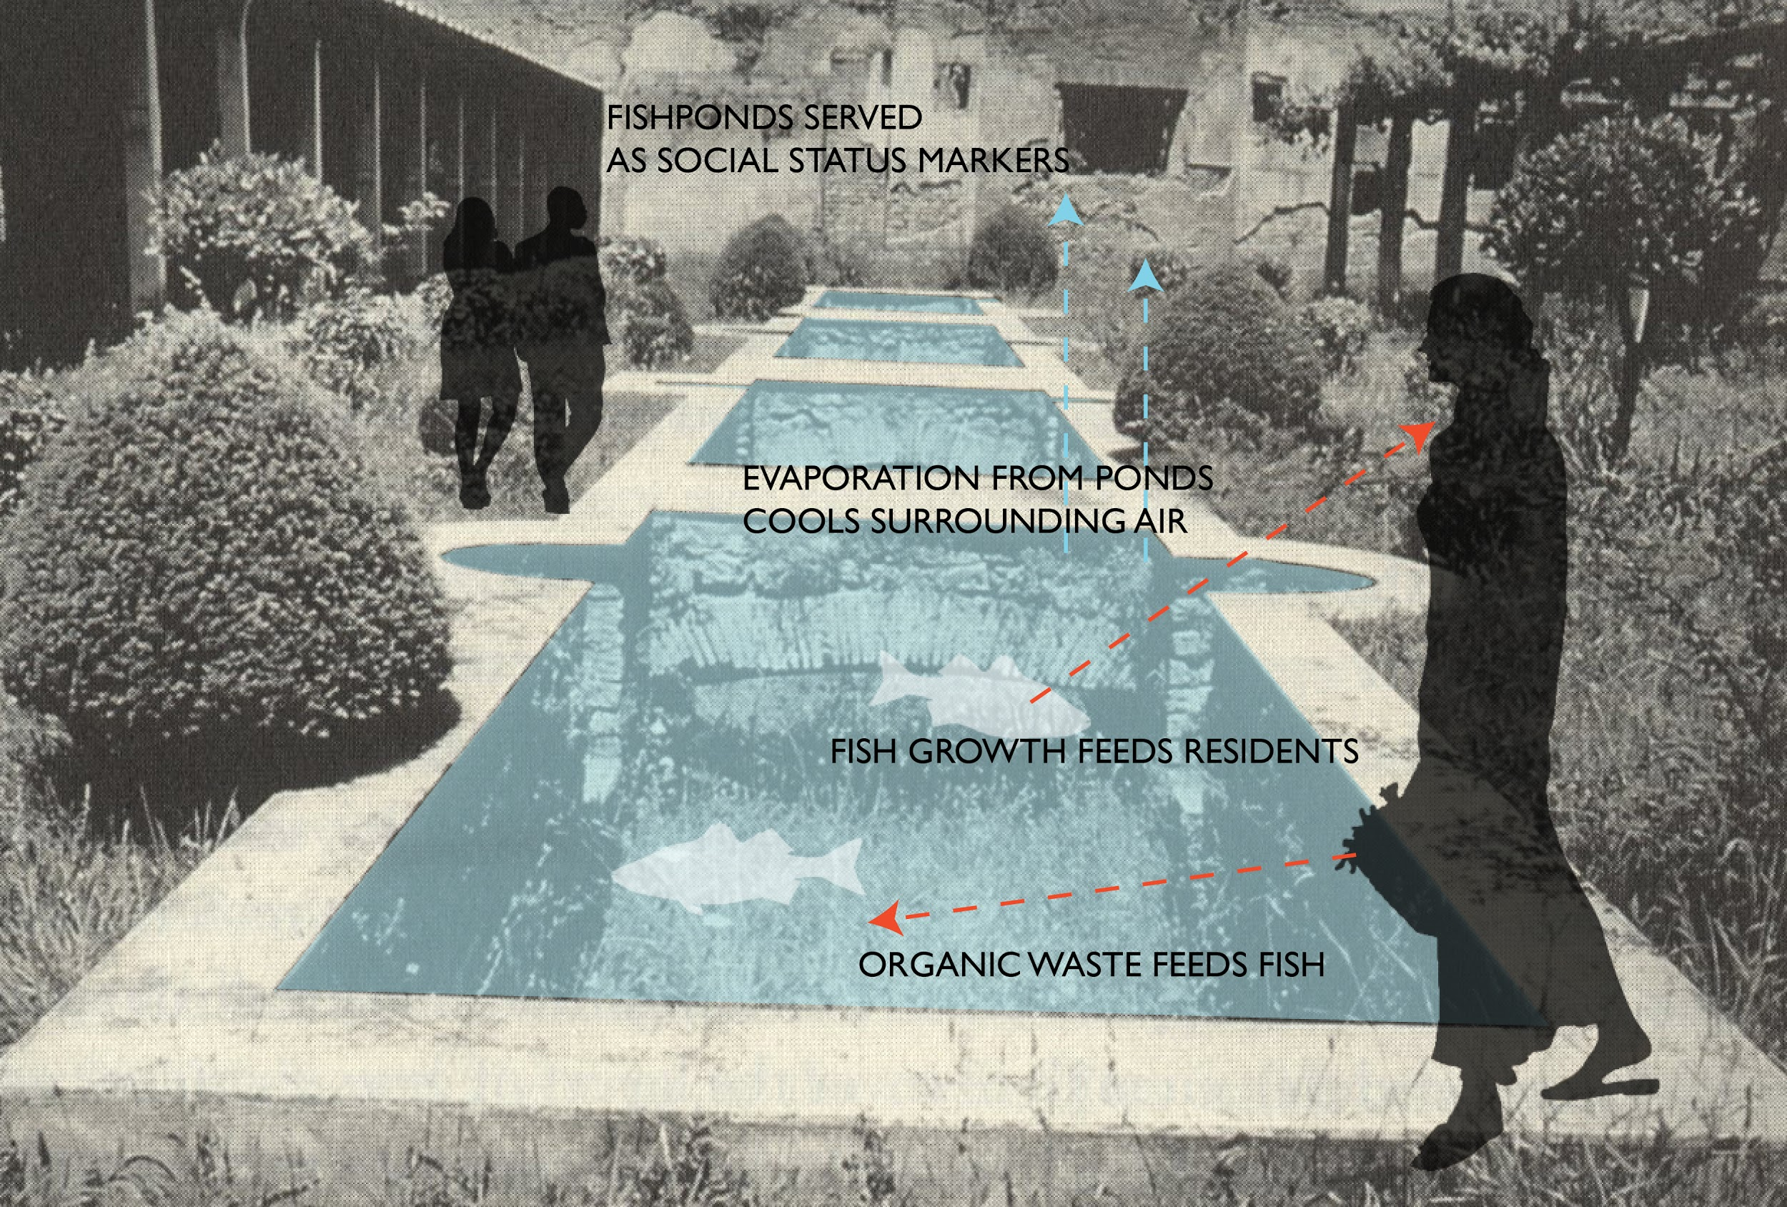
Roman- Mullet
And trouth

Slide 6
France
Birthplace of modern aquaculture
Noticed decline in Trout in native waters so started fertilizing eggs by hand and raising trout.
First Fish Hatchery established in 1852
Notes:
https://ec.europa.eu/fisheries/cfp/aquaculture/aquaculture_methods/history_en

Slide 7
Hawaii
400 AD
Freshwater fish ponds fed by canals from streams
Taro ponds that irrigated agricultural plots
Brackish water fish ponds located near the shoreline
Seawall fish ponds along the shoreline walled off from the ocean by human-made walls

Slide 8
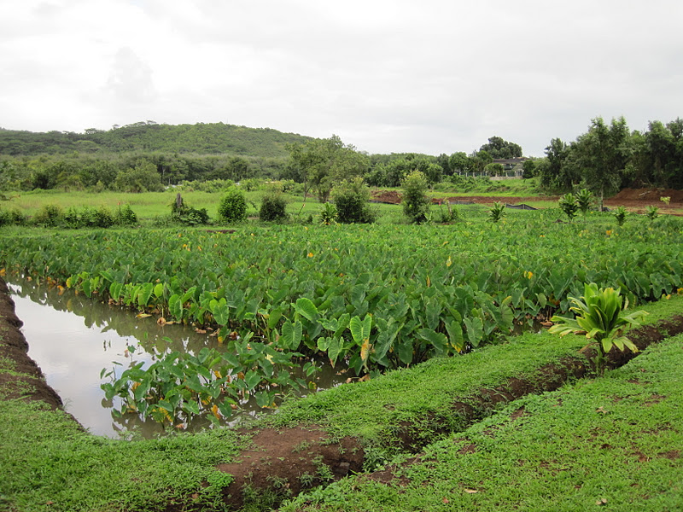

Slide 9
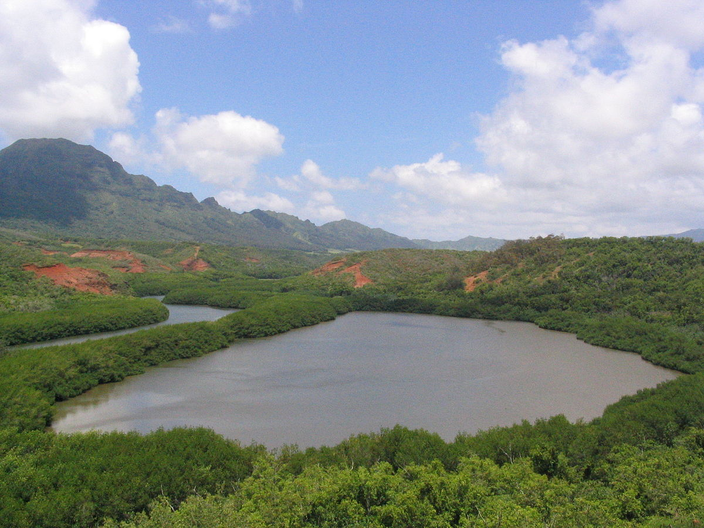
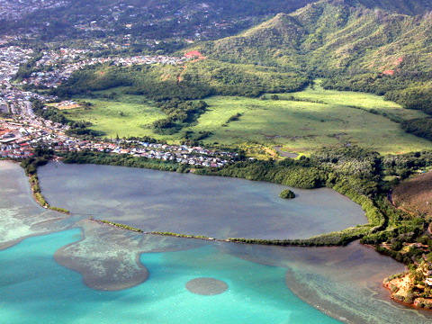
Notes:
Ancient hawaiian aquaculture

Slide 10
America
Southern California near Salton Sea the Cahuilla people built fish ponds
The Maya developed irrigation systems during 500-800 BC.

