Slide 1
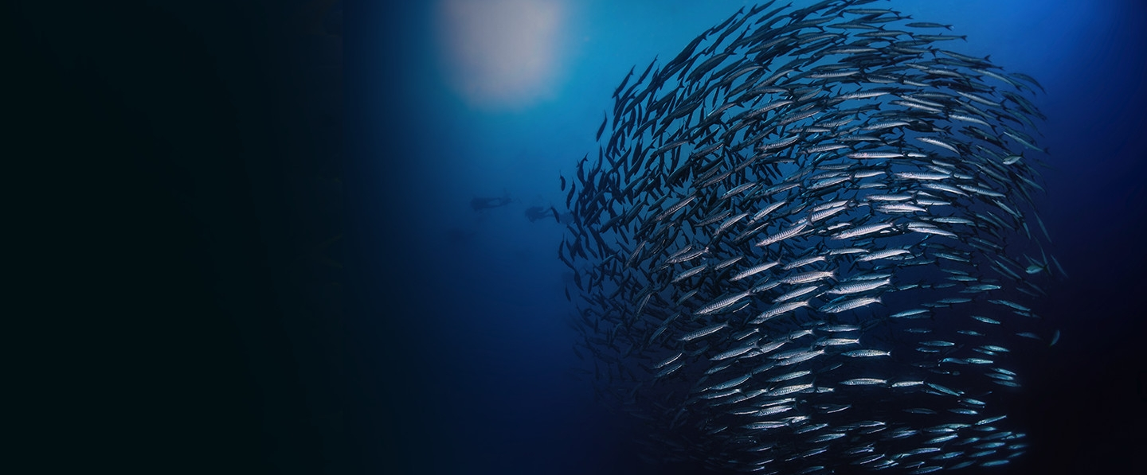
Aquaculture Quiz 2

Slide 2
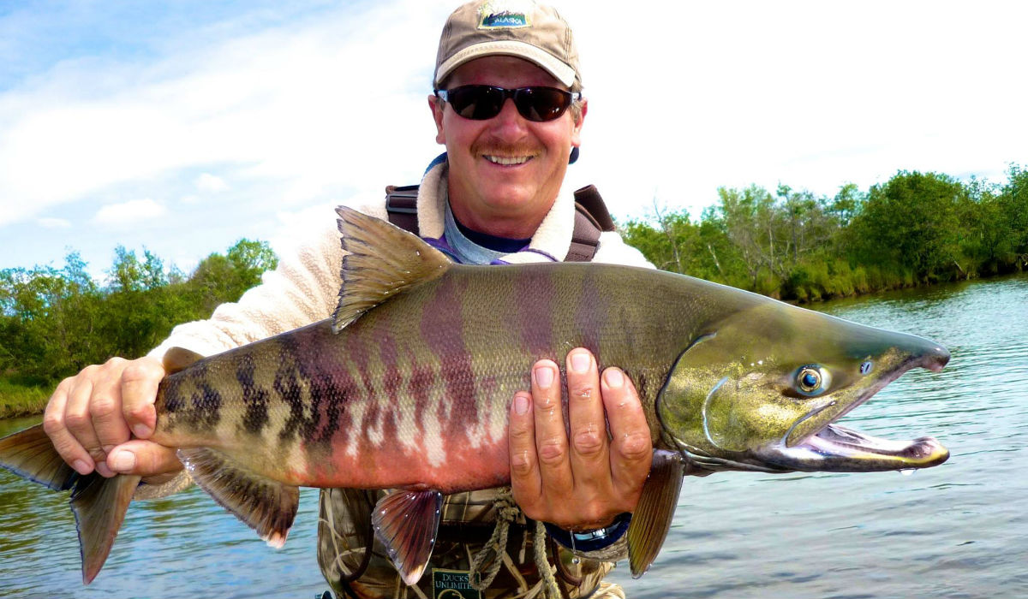
1.What species of Salmon is this? Common and scientific?

Slide 3
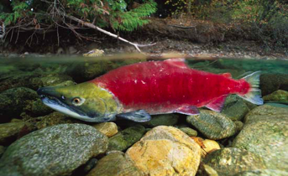
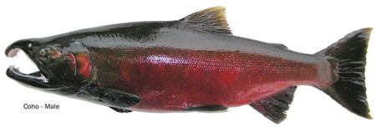
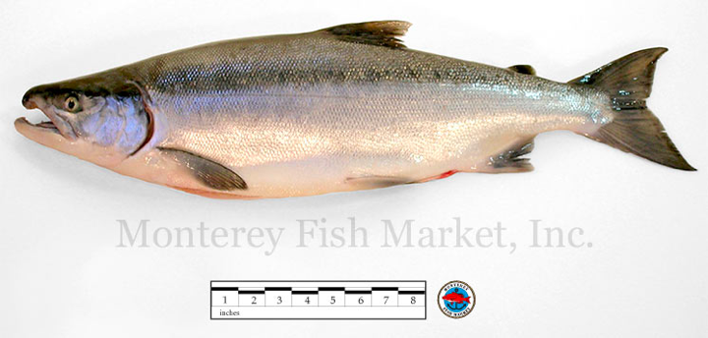
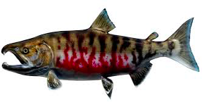
2.Name the four different species of salmon we learned in class?

Slide 4
3.Which species of salmon is the largest?

Slide 5
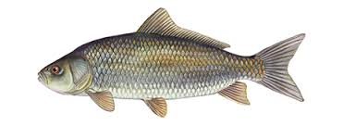
4. How many pounds of feed does it take to produce one pound of fish?
? pounds = 1 pound of

Slide 6
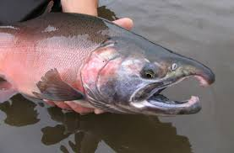
5. What does the latin word Oncorhynchus mean?

Slide 7
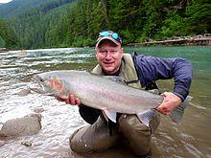
6. Is Stealhead a Salmon? If not, why?

Slide 8
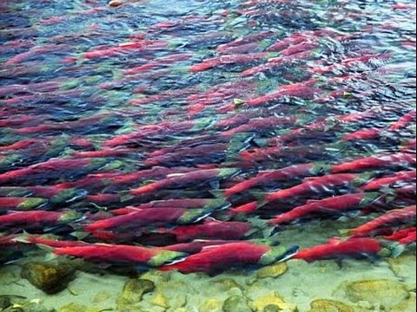
7. What does Anadromous mean?

Slide 9
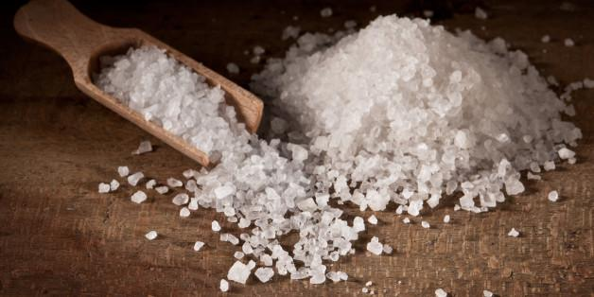
8. What is it called when a fish is able to tolerate a wide range of salinity?

Slide 10
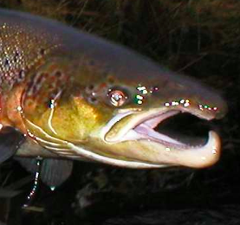
9. What is the lower part of the jaw called and what is it used for?

Slide 11
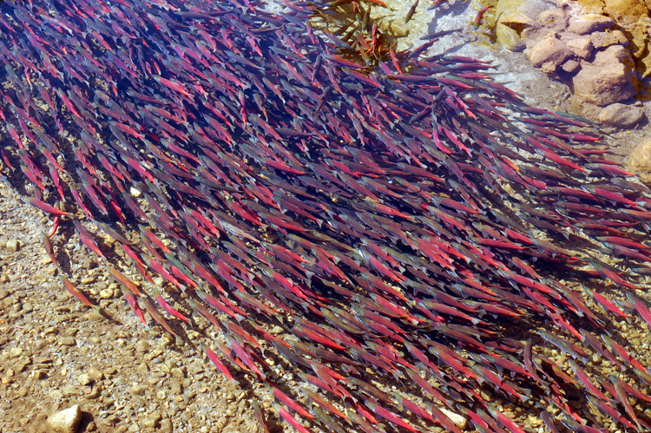
10. Name one structure that helps salmon migrate up river?

Slide 12
11. Name the developmental stages that salmon go through before they reach adulthood:

Slide 13
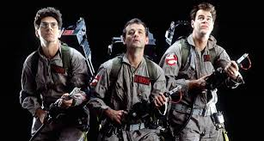
12.What is one of the ways people use to catch fish?

Slide 14
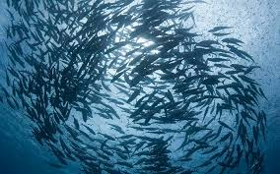
13.Name one thing that is threatening Salmon and/or Fish globally?

Slide 15
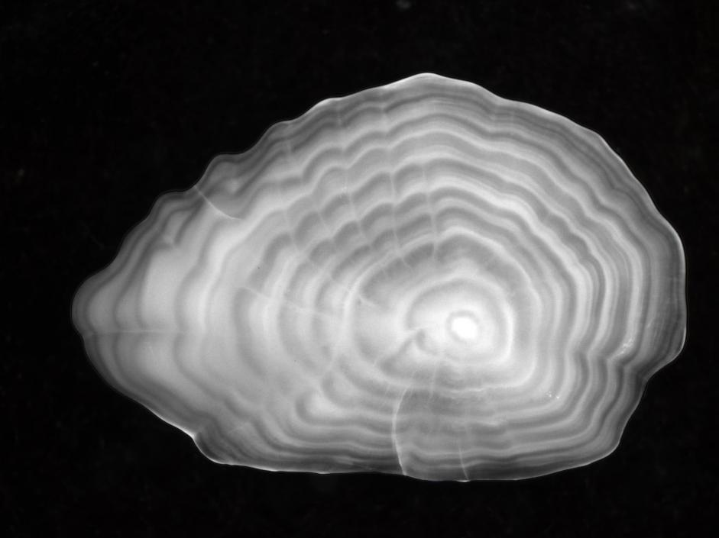
What is the way to tell the age of a fish?

Slide 16
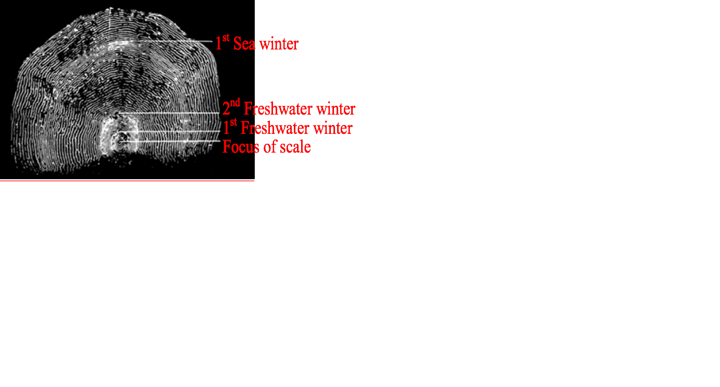
Bonus: What is scale reading?

