Slide 1
Animal science quiz 3
Livestock terms, beef cattle id, and swine id
mr. carpenter
September 14,2017

Slide 2
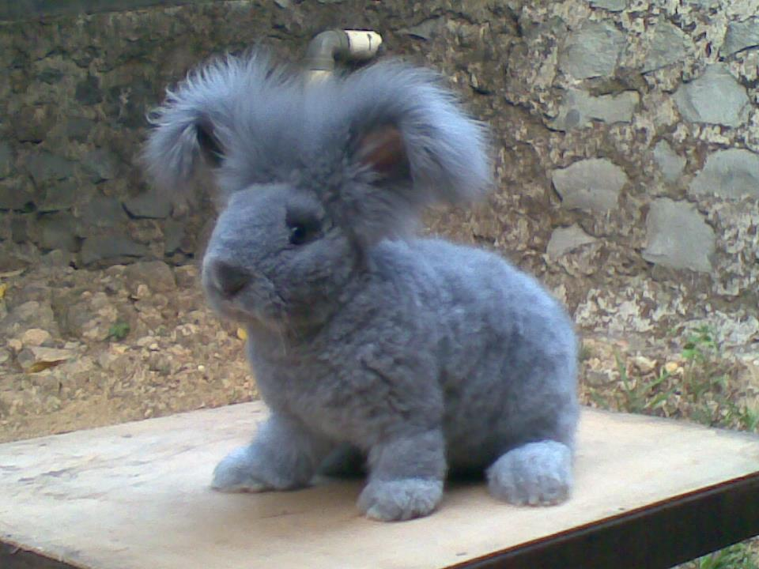
Female rabbit

Slide 3
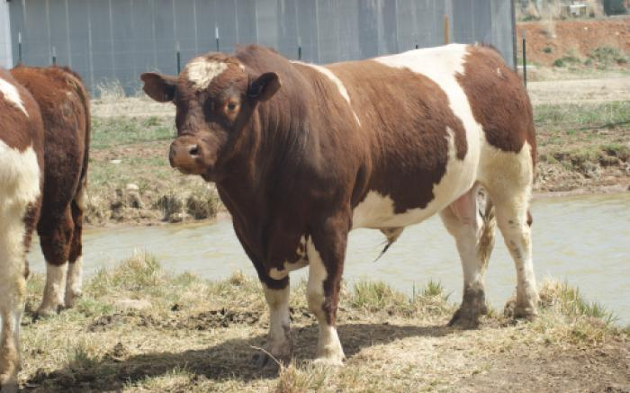
Name the breed.

Slide 4
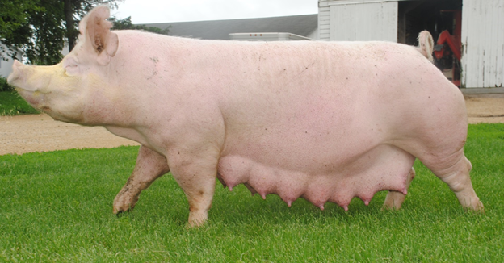
Name the swine breed.

Slide 5
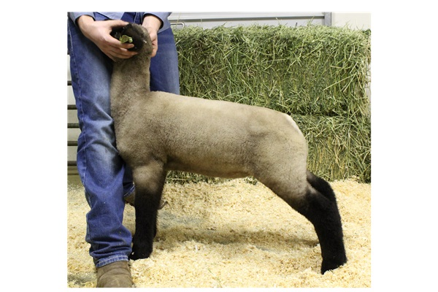
Castrated male sheep or goat

Slide 6
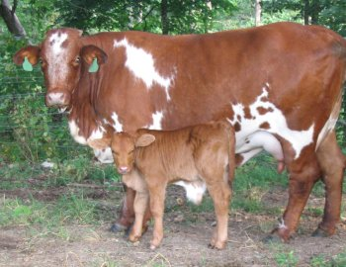
Name the beef breed.

Slide 7
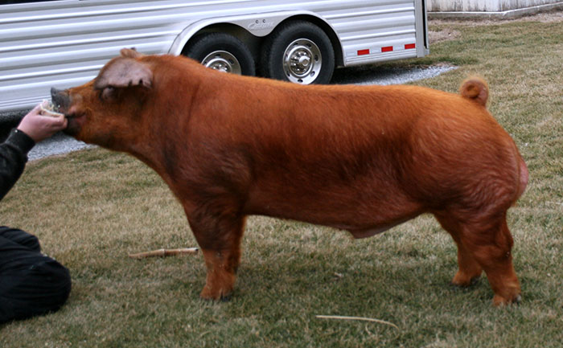
Name the swine breed.

Slide 8
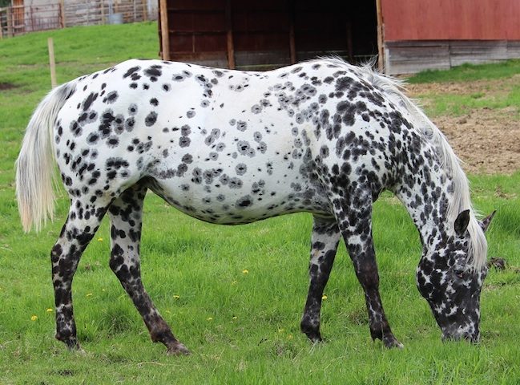
Adult female equine having produced offspring

Slide 9
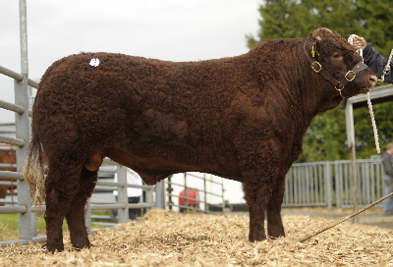
Name the beef breed.

Slide 10
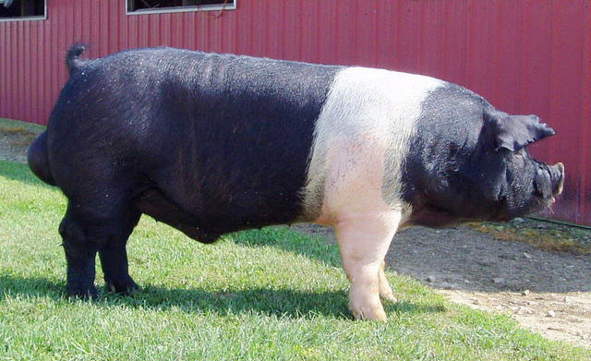
Name the swine breed.

Slide 11
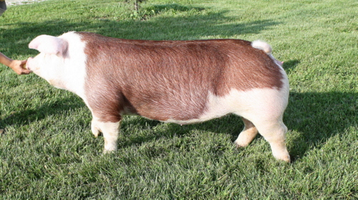
Young female swine- no offspring bonus- name the swine breed.

