Slide 1
Animal science livestock terminology Quiz #1 Bovines
Mr. Carpenter
Roots Agriculture Fall 2017

Slide 2
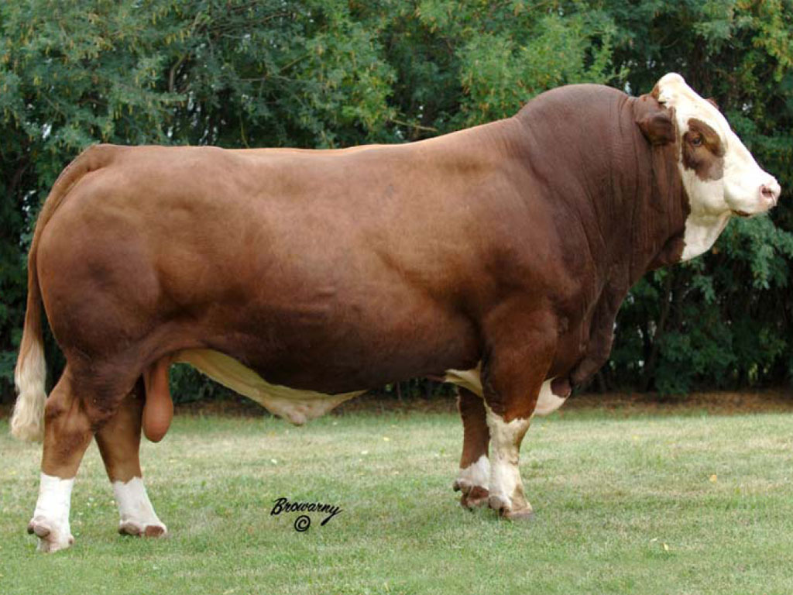

Slide 3
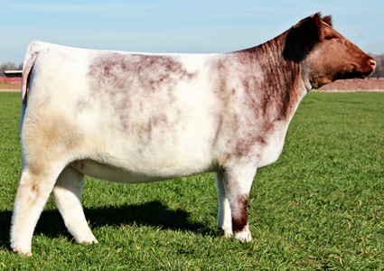

Slide 4
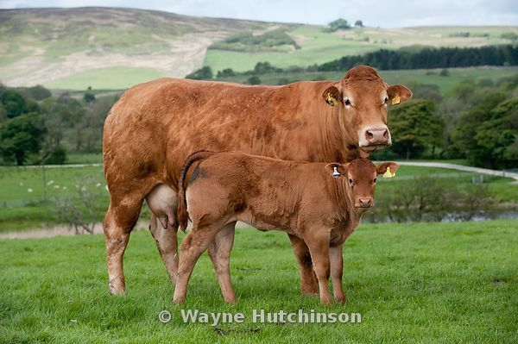

Slide 5
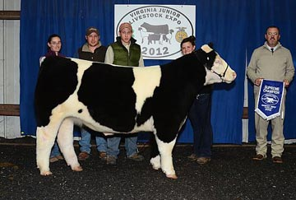

Slide 6
